Slide 1

Employment Management System
Presentation Demo
Kori

Slide 2
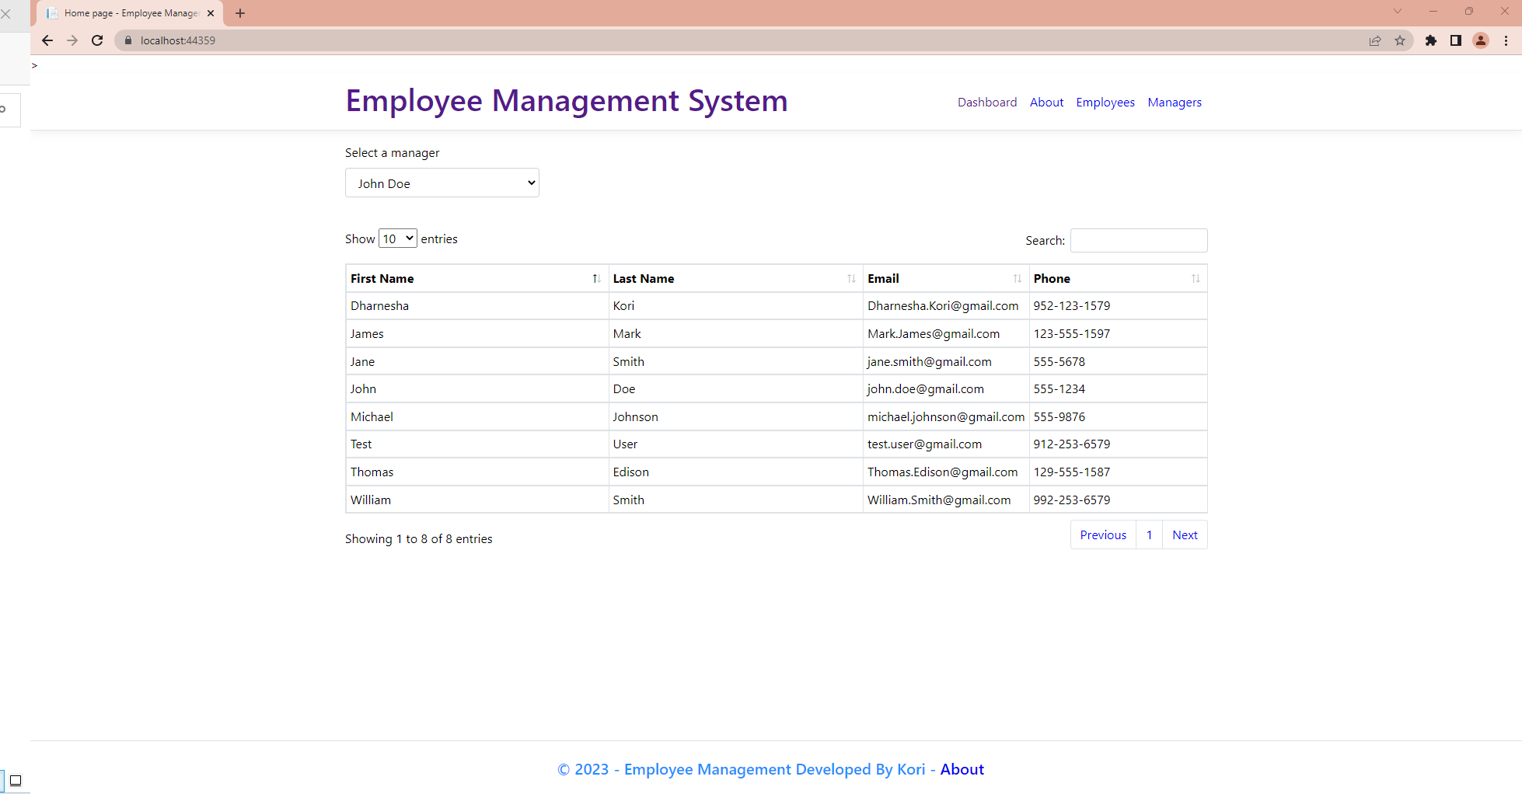

Slide 3
GIT Repository URLs
https://github.com/dharanesha-kori/EmployeeManagementAPI.git
https://github.com/dharanesha-kori/EmployeeManagementWeb.git

Slide 4
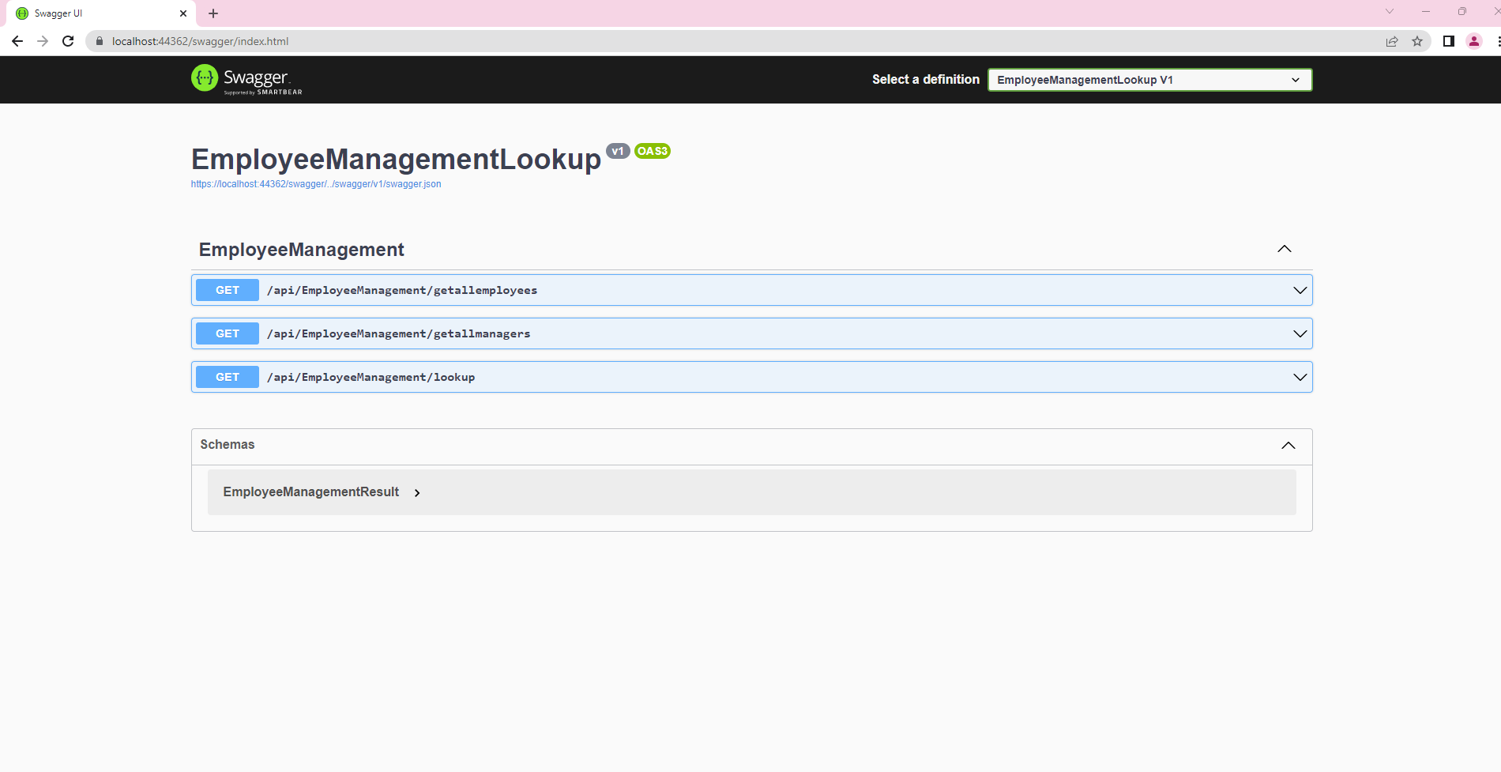
Web API - Swagger

Slide 5
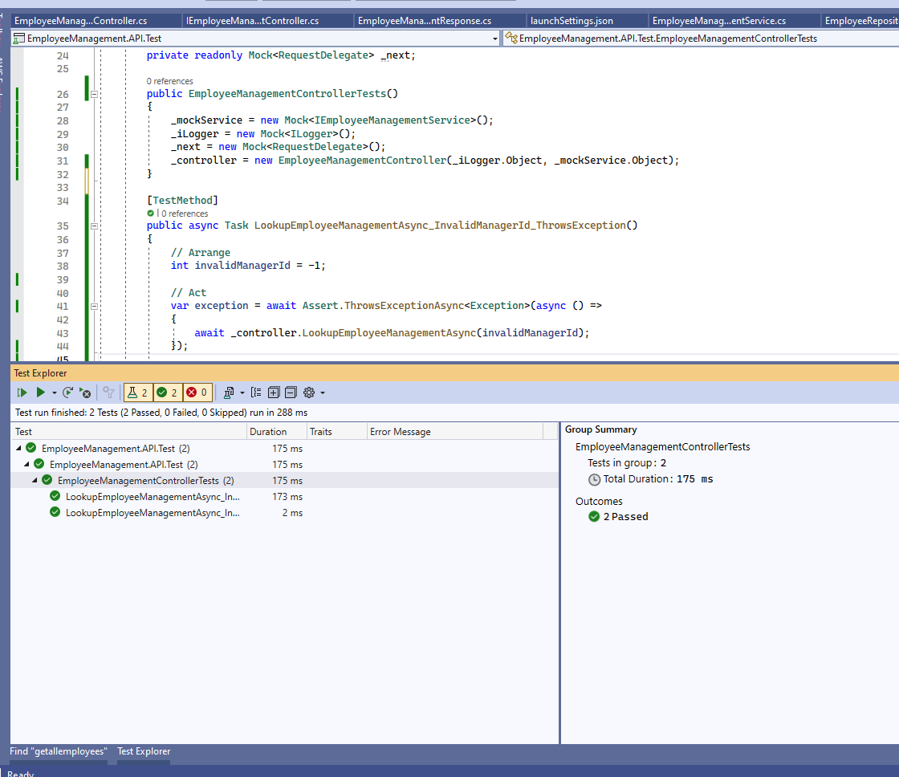
Unit test cases - coverage

Slide 6
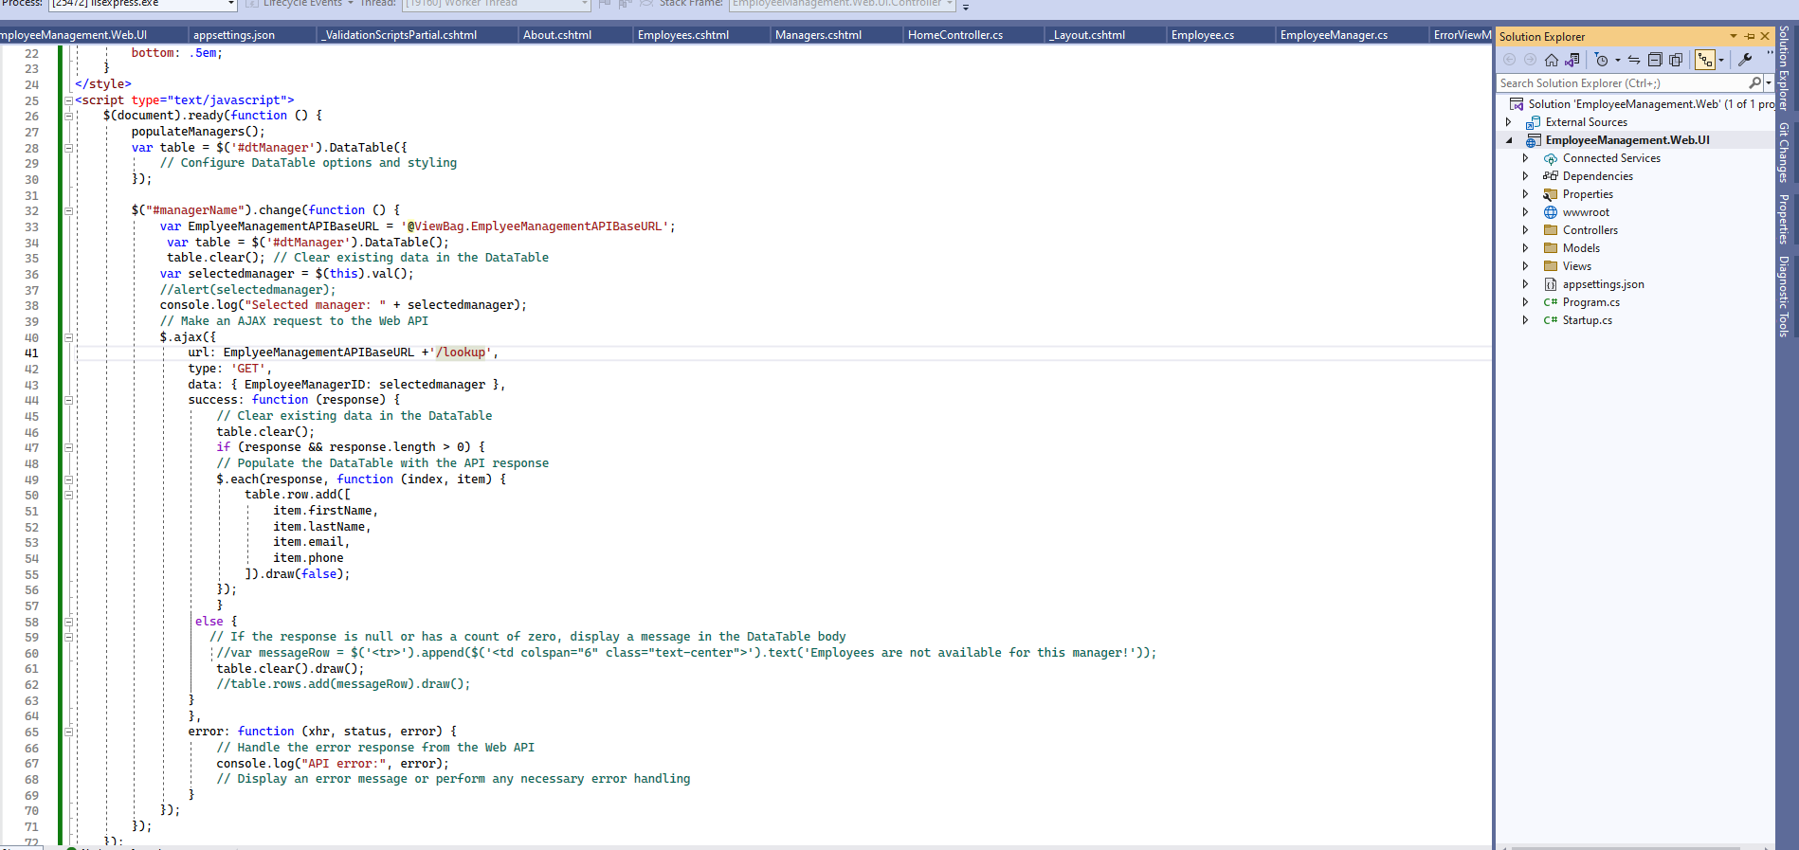

Slide 7
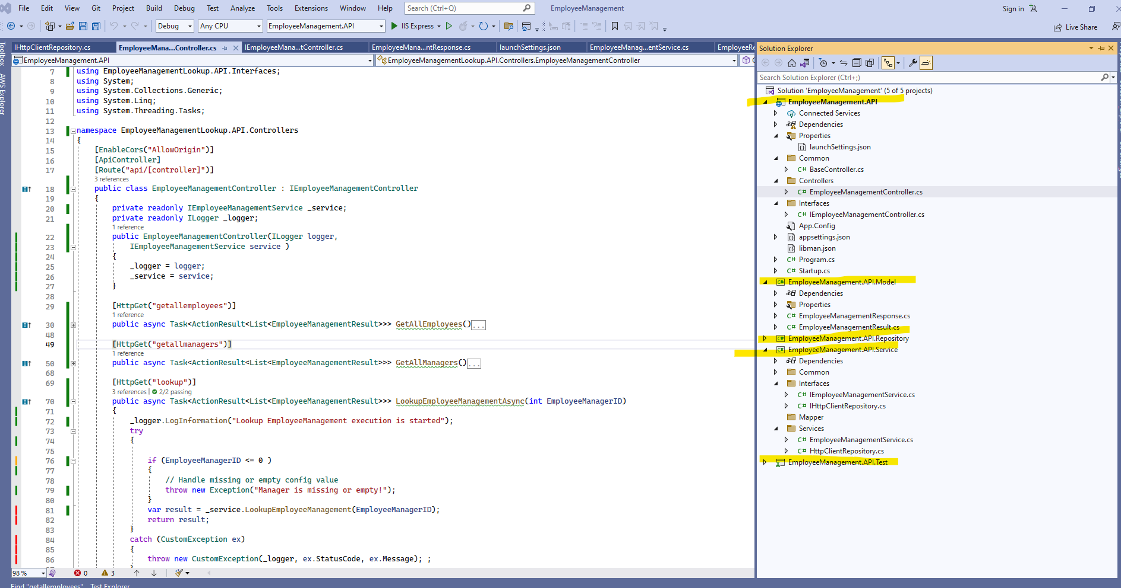

Slide 8
Thank You
- Kori

